Slide 1
Urban Planning & Cultural Diversity
COMP20008 Elements of data processing project phase 4
Wei How Ng (828472)

Slide 2
Research Question
“Does housing prices and policies affect language and cultural diversity in Victoria?”
“Could proper urban planning and change of real estate policies be useful to improve spatial segregation if present in Victoria”

Slide 3

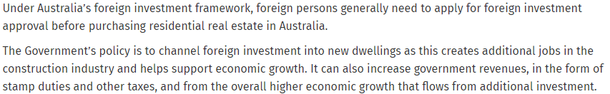
Australian Foreign Investment policies
Real Estate policies affect all visitors, investors, temporary residents and new immigrants.

Slide 4
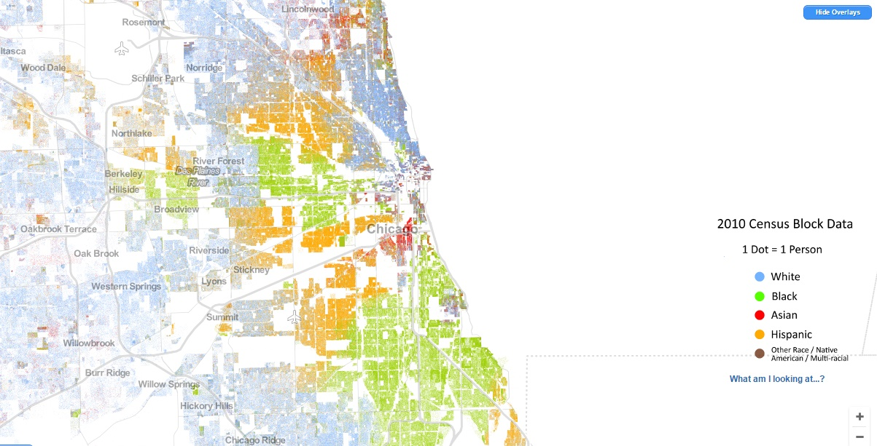
Spatial Segregation & Cultural Pockets

Slide 5
Spatial Segregation & Cultural Pockets
Increased immigration into Victoria in the recent years have caused speakers of languages of Asian origins to almost double.
Housing Policies affect where people buy their houses
Enclosed areas with a singularly high language concentrations are starting to become prominent
Good to identify socio-cultural problems from the start

Slide 6
Data Sets
Victorian Property Sales Report – Median House Prices by Suburb 2005-2015 Real Estate Prices of new dwellings
ABS Census Data Pack – T01 Selected Person Characteristics Population Density Data for each region
ABS Census Data Pack – T10 Language Spoken at Home by Sex Language Data to determine lingual and cultural diversity
ABS Australian Statistical Geography Standard – SA2 to LGA 2011 Data Region names and code matching data

Slide 7
Methodology – Wrangling
Year 2011 Data taken from Housing Prices, Languages and Population Data Sets.
Top 6 Languages Spoken in Victoria Selected including English-Only Arabic Languages, Chinese Languages, English Only, Italian, Greek and Vietnamese
2011 Total Persons per area extracted from Population dataset
Housing Prices data set had their null values replaced by region average
Operations not performed on areas with zero populations to avoid division by zero when finding concentration of language
The region names were put into strings and standard lower cases

Slide 8
Methodology – Implementation
1-gram string matching algorithm to match different region names in data
Region names further confirmed and matched by recombining data
Concentration of language calculated for each region in used set
Languages mapped out into heat maps
Concentration and Population of languages onto scatter plots
Case studies were done on areas with similar population but different language concentration; Particularly English Only speakers and Chinese languages speakers.
Housing Data referenced in the case studies

Slide 9
Results
English Only speakers have almost perfect positive correlation with population as expected, unlike Greek or Italian
Chinese language concentration showed further spread Comparable to Greek and Italian
Vietnamese speaking have cheapest house to language density
Several areas identified with rising concentrations of only one language due to real estate pricing

Slide 10
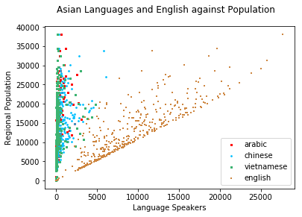
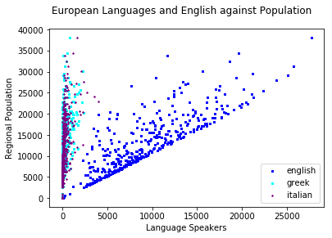

Slide 11
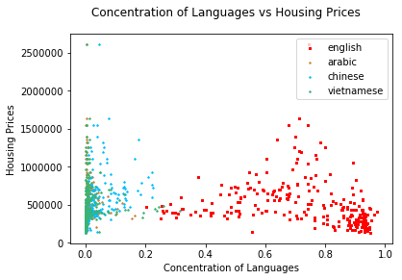
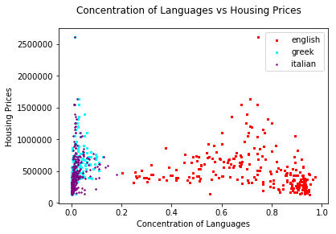
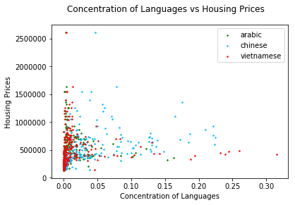
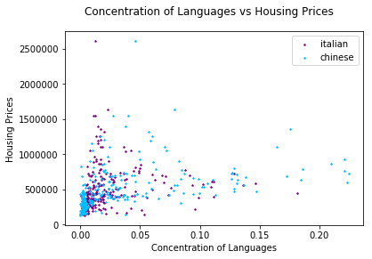

Slide 12
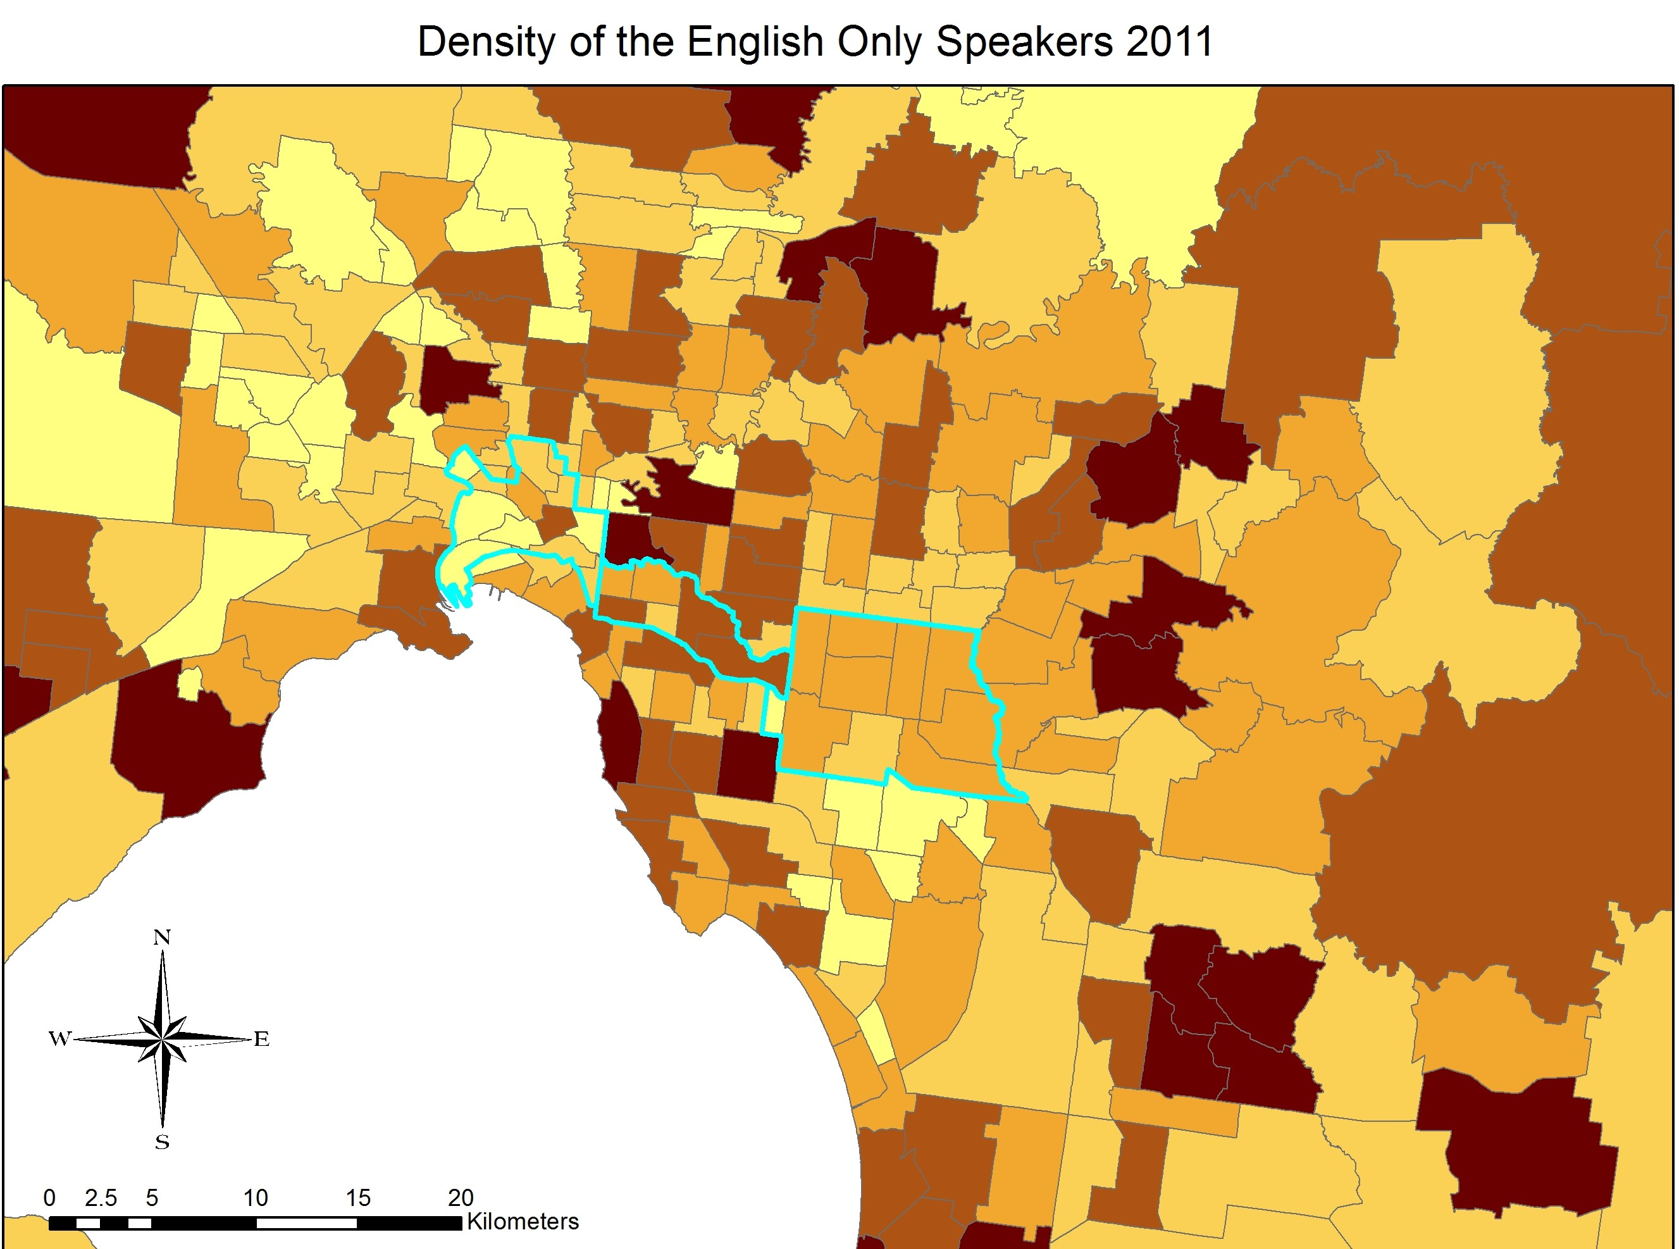

Slide 13
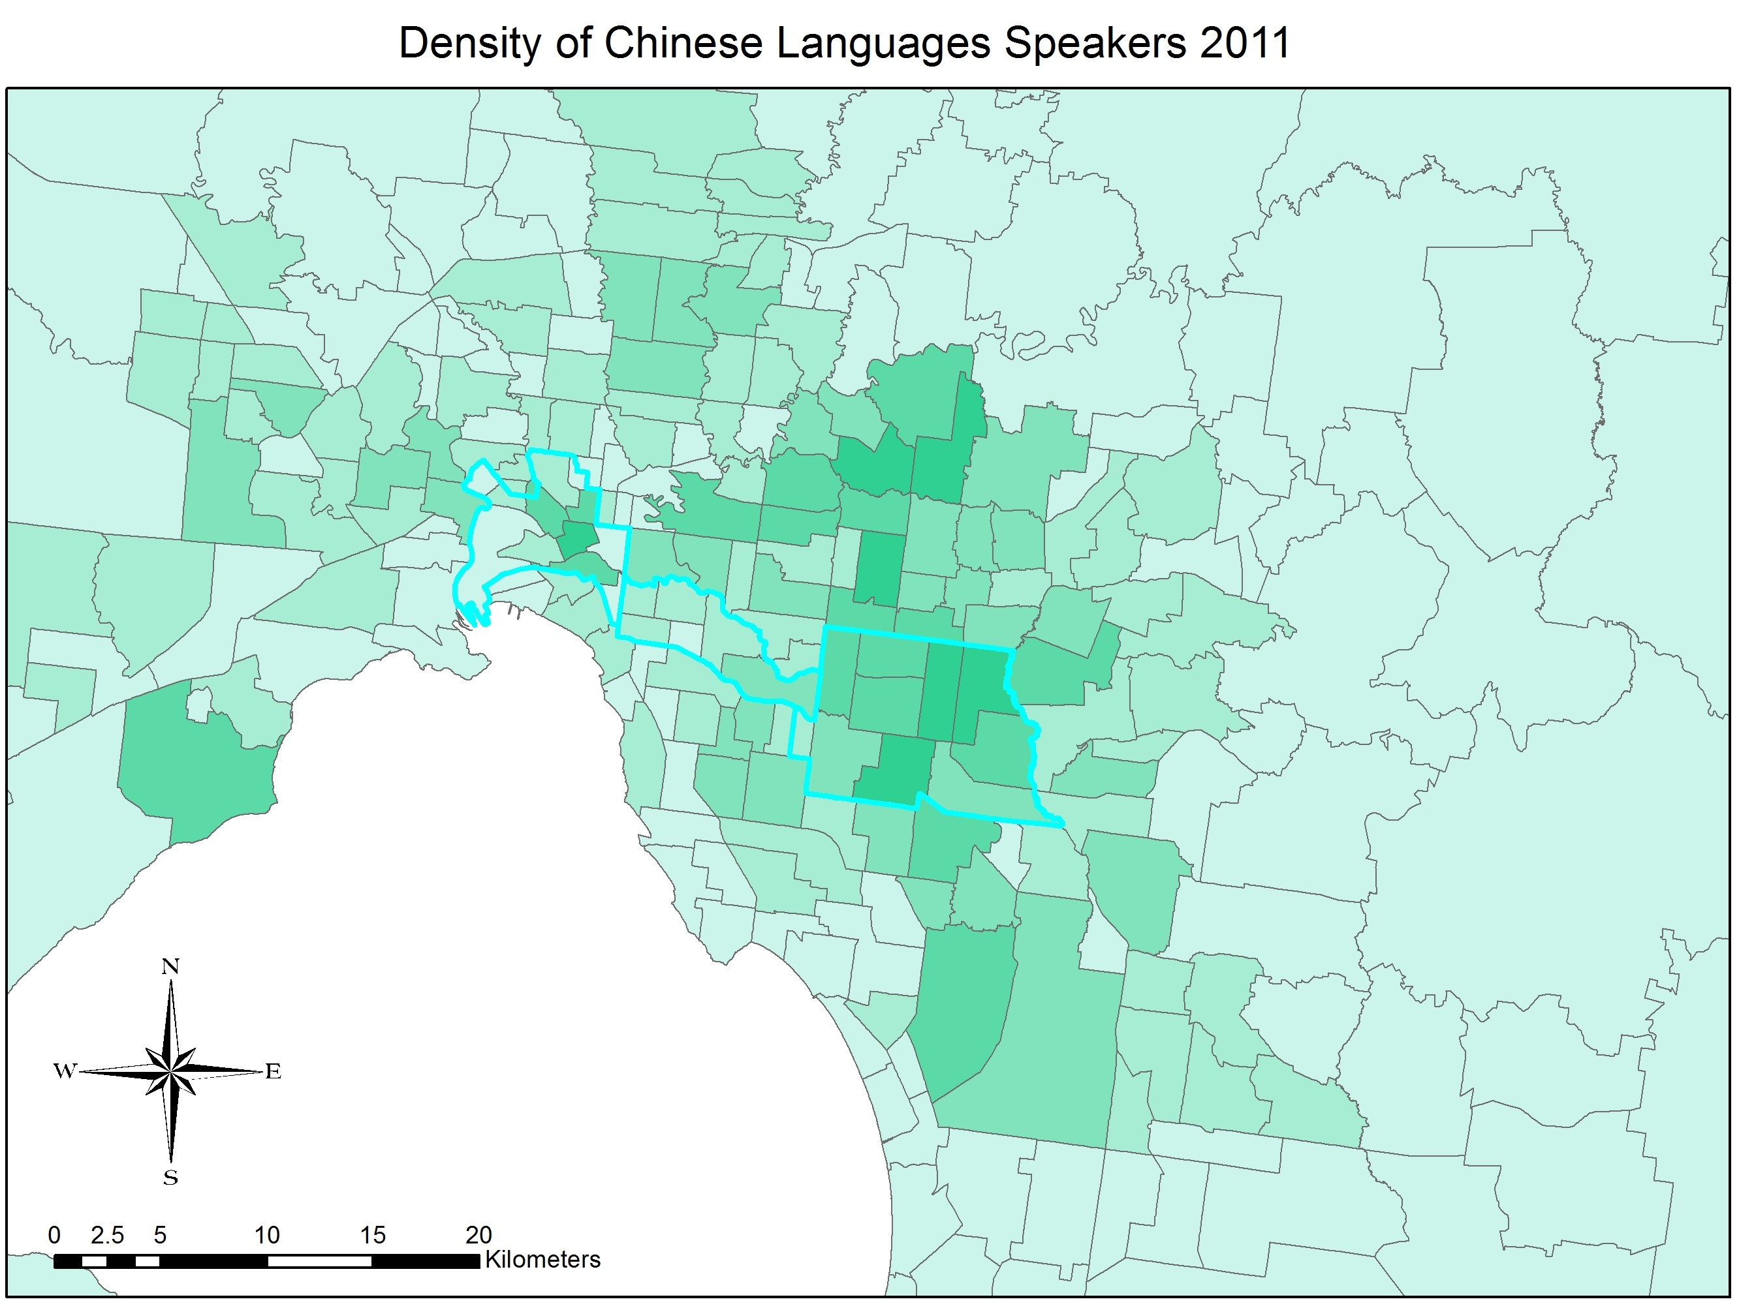

Slide 14
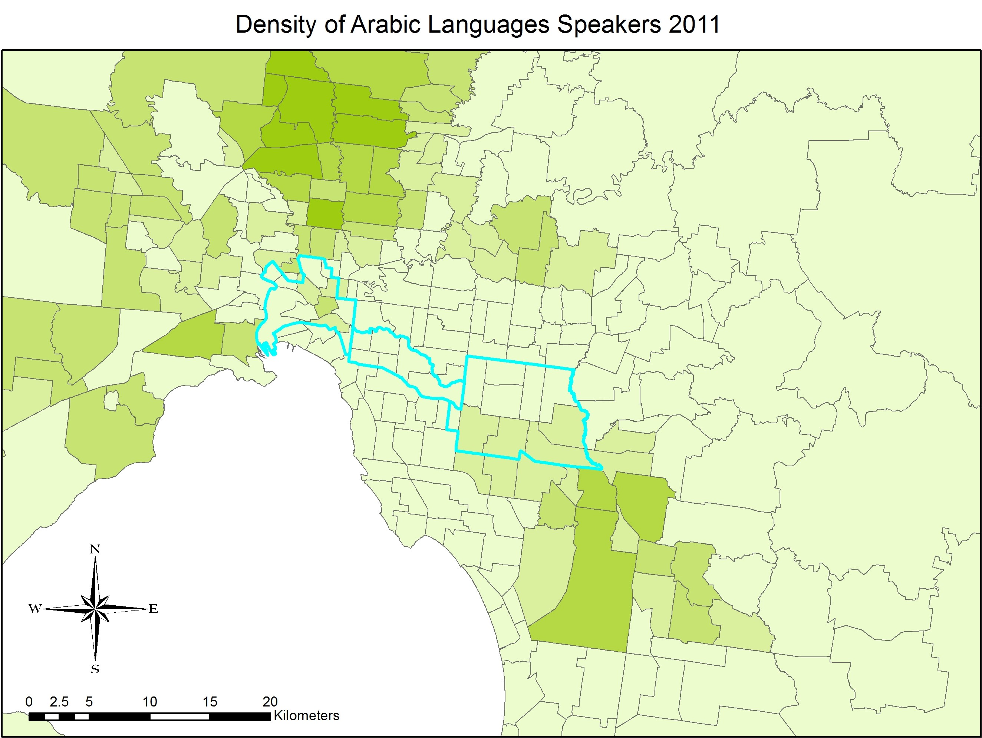

Slide 15
 | Dominant Language (Con) | Population | Housing Prices
Box Hill North | 0.173 (Chinese) | 16335 | 683000
Brighton East | 0.770 (English) | 15221 | 1100000
Meadow Heights | 0.154 (Arabic) | 14859 | 321500

Slide 16
Challenges & Reflection
Better string matching algorithm could be implemented into matching region names
Population density mapped onto a scatter plot with languages does not visualise the relationship between three factors well enough
Heat maps could be more area specific like the American ones
Selection of areas to conduct the case studies is manual and inefficient

Slide 17
Thank You
Questions?

